Slide 1

Chapter 18
Integrating Audio and Video

Slide 2
Learning Objectives
How the HTML 5 <video> and </video> tag pair can be used to include a video file within a webpage
How video files can be saved in a variety of file formats, which not all browsers support
How to support common browsers by providing multiple video file formats within your webpage
. How to support the <video> and </video> tag pair with older browsers by embedding video within your webpage using the <embed> or <object> tags
How t developers can optimize video quality or the video file size by compressing video using different formats called codecs
How to use the HTML 5 <audio> and </audio> tag pair to include an audio file within a webpage
How to save a variety of file formats through audio files
How to provide multiple audio file formats within your webpage to support common browsers

Slide 3
Learning objectives continued
How to embed video within your webpage using the <embed> or <object> tags because older browsers do not support the <audio> and </audio> tag pair
How to control video playback within a webpage by using the JavaScript programming language,
How to integrate media players into your webpage using JavaScript

Slide 4
Using HTML 5 Video Is Supposed To Be Easy
To simplify the process of placing a video clip within a webpage, HTML 5 provides the <video> and </video> tag pair. In the ideal sense, using the <video> tag is similar to placing an image within a page. Use the <video> tag src attribute to specify the location of the video file:
<video src=“http://www.WebSiteDevelopmentBook.com/Chapter18/Cigar.mp3”> </video>

Slide 5
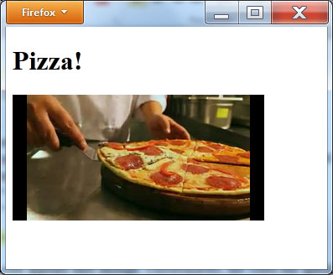
First video
<!DOCTYPE html>
<html>
<body>
<h1>Pizza!</h1>
<video src="http://www.WebSiteDevelopmentBook.com/Chapter18/Pizza.mp4" autoplay="autoplay"></video>
</body>
</html>

Slide 6
Specifying multiple video formats
<!DOCTYPE html>
<html>
<body>
<h1>Wine!</h1>
<video autoplay="autoplay">
<source src="http://www.WebsiteDevelopmentBook.com/Chapter18/Wine.mp4" type="video/mp4"/>
<source src="http://www.WebsiteDevelopmentBook.com/Chapter18/Wine.ogg" type="video/ogg"/>
<source src="http://www.WebsiteDevelopmentBook.com/Chapter18/Wine.flv" type="video/flv"/>
<source src="http://www.WebsiteDevelopmentBook.com/Chapter18/Wine.webm" type="video/webm"/>
<source src="http://www.WebsiteDevelopmentBook.com/Chapter18/Wine.mov" type="video/mov"/>
Video Tag Not Supported
</video>
</body>
</html>

Slide 7
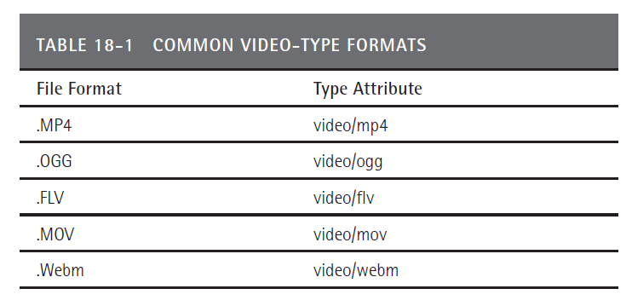
Video file formats

Slide 8
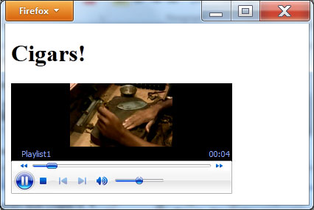
Using video controls
<!DOCTYPE html>
<html>
<body>
<h1>Cigars!</h1>
<video autoplay="autoplay" controls="controls">
<source src="http://www.WebsiteDevelopmentBook.com/Chapter18/Cigar.mp4" type="video/mp4"/>
<source src="http://www.WebsiteDevelopmentBook.com/Chapter18/Cigar.ogg" type="video/ogg"/>
<source src="http://www.WebsiteDevelopmentBook.com/Chapter18/Cigar.flv" type="video/flv"/>
<source src="http://www.WebsiteDevelopmentBook.com/Chapter18/Cigar.webm" type="video/webm"/>
<source src="http://www.WebsiteDevelopmentBook.com/Chapter18/Cigar.mov" type="video/mov"/>
Video Tag Not Supported
</video>
</body>
</html>

Slide 9
Streaming vs downloaded video
In general, there are two video types: streaming and downloaded. A streaming video can start playing after the browser downloads part of the video (enough video to get started). A downloaded video, in contrast, must download completely to the user’s system before it can play. Depending on the video’s size (a video file can become large quickly), a downloaded video may force the user to wait a considerable amount of time before it begins to play. This does not provide a good user experience.
Some video file formats support streaming, and others do not. The common streaming video file formats include: WebM (Google), MP4, Ogg, MOV (Quicktime), RM (Real Media), and FLV (Flash video). When you place a video file within a webpage, use a streaming video file format.

Slide 10
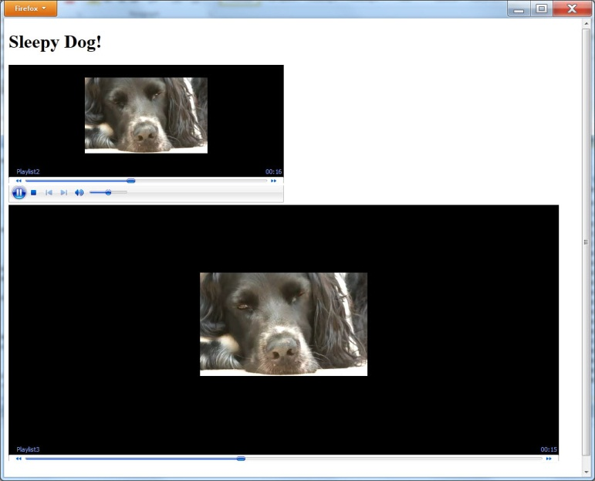
Video file size
<!DOCTYPE html> <html> <body> <h1>Sleepy Dog!</h1> <video autoplay="autoplay" controls="controls" height="240" width"320"> <source src="http://www.WebsiteDevelopmentBook.com/Chapter18/Dog.webm" type="video/webm"/> <source src="http://www.WebsiteDevelopmentBook.com/Chapter18/Dog.ogg" type="video/ogg"/> <source src="http://www.WebsiteDevelopmentBook.com/Chapter18/Dog.mp4" type="video/mp4"/> <source src="http://www.WebsiteDevelopmentBook.com/Chapter18/Dog.flv" type="video/flv"/> <source src="http://www.WebsiteDevelopmentBook.com/Chapter18/Dog.mov" type="video/mov"/> Video Tag Not Supported </video> <br/> <video autoplay="autoplay" controls="controls" height="480" width"640"> <source src="http://www.WebsiteDevelopmentBook.com/Chapter18/Dog.ogg" type="video/ogg"/> <source src="http://www.WebsiteDevelopmentBook.com/Chapter18/Dog.mp4" type="video/mp4"/> <source src="http://www.WebsiteDevelopmentBook.com/Chapter18/Dog.flv" type="video/flv"/> <source src="http://www.WebsiteDevelopmentBook.com/Chapter18/Dog.webm" type="video/webm"/> <source src="http://www.WebsiteDevelopmentBook.com/Chapter18/Dog.mov" type="video/mov"/> Video Tag Not Supported </video> </body> </html>

Slide 11
Understanding video codecs
A video file is essentially a big collection of ones and zeros that define the pictures that make up the video as well as the audio. To improve the quality of the video and audio or to speed up the video download, apply different compression formats to a video file. Developers refer to these formats at codecs. There are a variety of codecs you can use when you save a video file. The three most common codecs include: H.264, Theora, and V8. Unfortunately, not all browsers support each.

Slide 12
Supporting older browsers
<!DOCTYPE html>
<html>
<body>
<h1>Parrot!</h1>
<embed src="http://www.WebSiteDevelopmentBook.com/Chapter18/Parrot.mp4" height="240" width="320"></embed>
<object src="http://www.WebSiteDevelopmentBook.com/Chapter18/Parrot.mp4" height="240" width="320"></object>
</body>
</html>

Slide 13
Supporting all browsers
<!DOCTYPE html>
<html>
<body>
<h1>Horses!</h1>
<video autoplay="autoplay">
<source src="http://www.WebsiteDevelopmentBook.com/Chapter18/Horse.mp4" type="video/mp4"/>
<source src="http://www.WebsiteDevelopmentBook.com/Chapter18/Horse.ogg" type="video/ogg"/>
<source src="http://www.WebsiteDevelopmentBook.com/Chapter18/Horse.flv" type="video/flv"/>
<source src="http://www.WebsiteDevelopmentBook.com/Chapter18/Horse.webm" type="video/webm"/>
<source src="http://www.WebsiteDevelopmentBook.com/Chapter18/Horse.mov" type="video/mov"/>
<embed src="http://www.WebSiteDevelopmentBook.com/Chapter18/Horse.mp4" height="240" width="320"></embed>
<object src="http://www.WebSiteDevelopmentBook.com/Chapter18/Horse.mp4" height="240" width="320"></object>
</video>
</body>
</html>

Slide 14
Directing the browser to buffer video
When a browser downloads an HTML page, it examines the HTML tags and begins to download related files, such as photos on the page. If your webpage contains a video that you do not want to start automatically after the page loads but that you think the user will ultimately start, you can direct the browser to start downloading and buffering the video file. In this way, when the user later starts the video, the browser can begin to play it without a downloading delay.
To direct the browser to begin buffering video, use the <video> tag preload attribute. If the video is set to autoplay, the browser automatically begins to buffer the video and ignores the preload attribute.

Slide 15
Using poster to display a default photo
<!DOCTYPE html>
<html>
<body>
<h1>Clouds!</h1>
<video controls="controls" poster="http://www.WebSiteDevelopmentBook.com/Chapter18/Cloud.jpg">
<source src="http://www.WebsiteDevelopmentBook.com/Chapter18/Clouds.mp4" type="video/mp4"/>
<source src="http://www.WebsiteDevelopmentBook.com/Chapter18/Clouds.ogg" type="video/ogg"/>
<source src="http://www.WebsiteDevelopmentBook.com/Chapter18/Clouds.flv" type="video/flv"/>
<source src="http://www.WebsiteDevelopmentBook.com/Chapter18/Clouds.webm" type="video/webm"/>
<source src="http://www.WebsiteDevelopmentBook.com/Chapter18/Clouds.mov" type="video/mov"/>
</video>
</body>
</html>

Slide 16
Looping a video
<!DOCTYPE html>
<html>
<body>
<h1>Hiker!</h1>
<video autoplay="autoplay" loop="true">
<source src="http://www.WebsiteDevelopmentBook.com/Chapter18/Hiker.mp4" type="video/mp4"/>
<source src="http://www.WebsiteDevelopmentBook.com/Chapter18/Hiker.ogg" type="video/ogg"/>
<source src="http://www.WebsiteDevelopmentBook.com/Chapter18/Hiker.flv" type="video/flv"/>
<source src="http://www.WebsiteDevelopmentBook.com/Chapter18/Hiker.webm" type="video/webm"/>
<source src="http://www.WebsiteDevelopmentBook.com/Chapter18/Hiker.mov" type="video/mov"/>
</video>
</body>
</html>

Slide 17
Letting youtube handle your videos
You may be thinking that video processing within a webpage is too challenging or too much effort. To simplify such processing, many users upload videos to You Tube and then run the videos from there by embedding references to the video within their HTML file. Although You Tube simplifies the process, using You Tube may subject your videos to advertising.

Slide 18
Placing audio in a web site
<!DOCTYPE html>
<html>
<body>
<h1>Rock!</h1>
<audio controls="controls">
<source src="http://www.WebsiteDevelopmentBook.com/Chapter18/Rock.mp3" type="audio/mp3"/>
<source src="http://www.WebsiteDevelopmentBook.com/Chapter18/Rock.ogg" type="audio/ogg"/>
</audio>
</body>
</html>

Slide 19
Audio support for older browsers
<!DOCTYPE html>
<html>
<body>
<h1>Jazz!</h1>
<embed src="http://www.WebSiteDevelopmentBook.com/Chapter18/jazz.mp3"></embed>
<object src="http://www.WebSiteDevelopmentBook.com/Chapter18/jazz.mp3"></object>
</body>
</html>

Slide 20
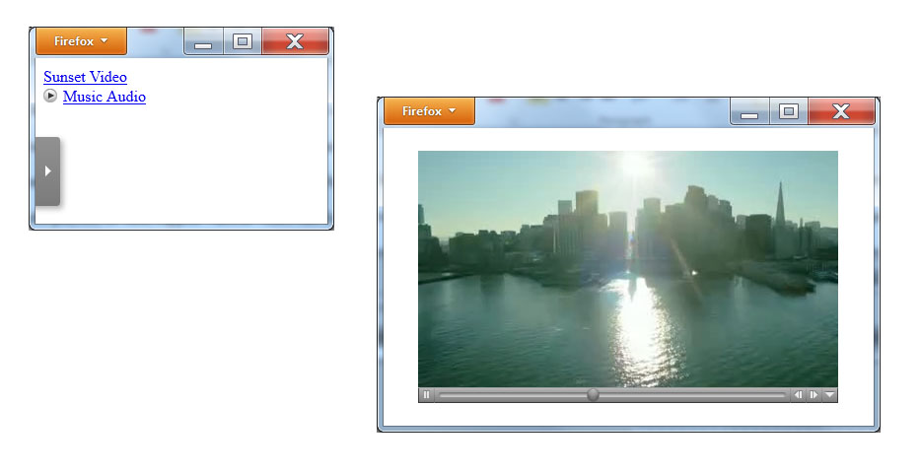
Real world: Yahoo media player
<!DOCTYPE html>
<html>
<body>
<a href="http://www.WebSiteDevelopmentBook.com/Chapter18/Sunset.mp4">Sunset Video</a><br/>
<a href="http://www.WebSiteDevelopmentBook.com/Chapter18/Cold.mp3">Music Audio</a>
<script type="text/javascript" src="http://mediaplayer.yahoo.com/js"></script>
</body>
</html>

Slide 21
summary
You can make extensive use of phone-based video cameras to record content you later want to post on the Web. Likewise, audio-based podcasts that can play from a PC or mobile device have become very popular.
As you design webpages, there will be times when you integrate video or audio content into your page. In an attempt to make such integration easier, HTML 5 introduced the <video> and <audio> tags.
Unfortunately, because not all browsers support HTML 5, and because different browsers support different audio and video file formats, the process of integrating audio and video into a webpage remains complex.
In this chapter, you learned how to use the HTML 5 video and audio capabilities while continuing to provide support for older browsers.

